Slide 1
Reinforcement and Online Learning
Arunabh singh – W10D3 July 2020 cohort

Slide 2
Online Learning
Online Learning means processing input piece by piece in an serial fashion.
Each new data point triggers online learning.
It is not mini batching.
SGD is just one type of online learning algorithm. There are many other online learning algorithms that may not depend on gradients (e.g. perceptron algorithm, bayesian inference, etc).

Slide 3
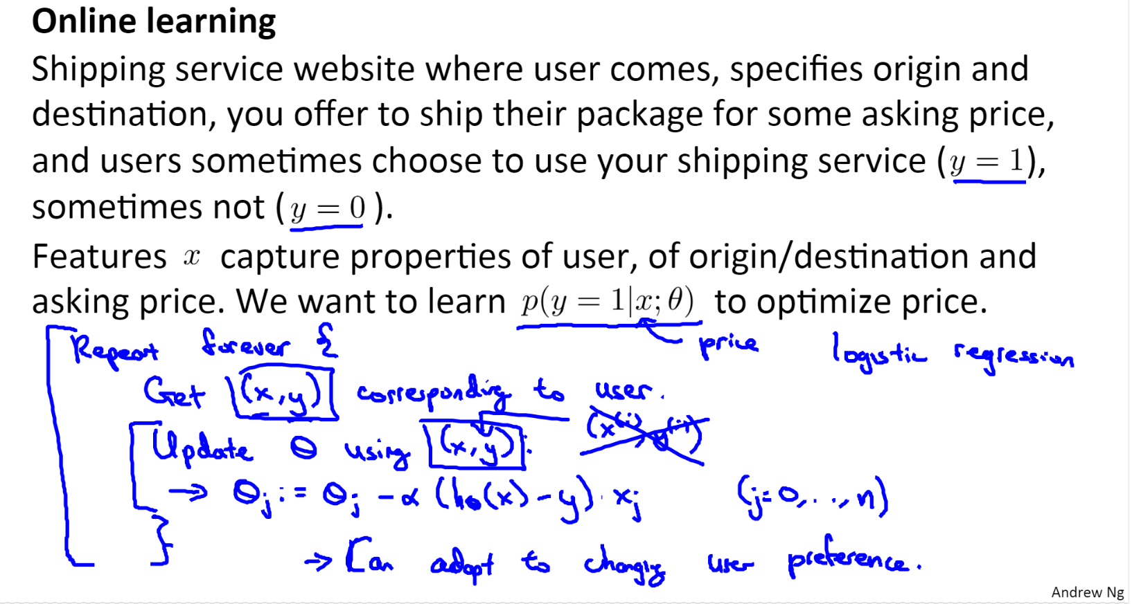
Online Learning Example
Source: Andrew Ng Coursera

Slide 4
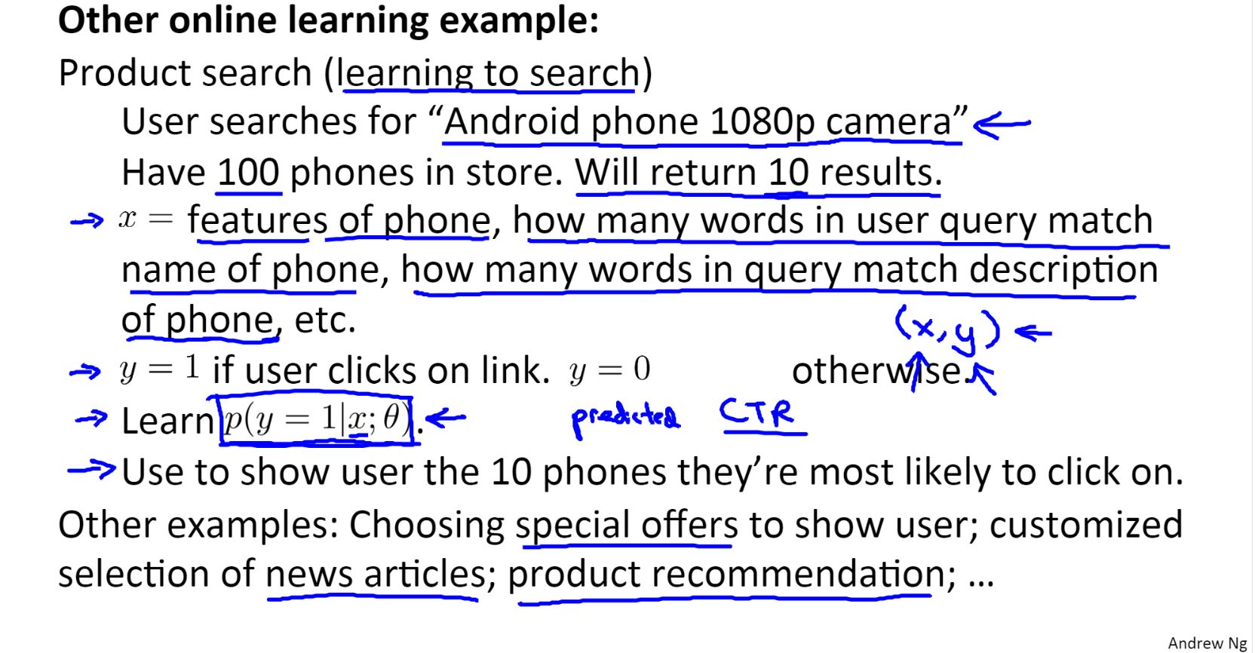
Online Learning Example 2
Source: Andrew Ng Coursera

Slide 5
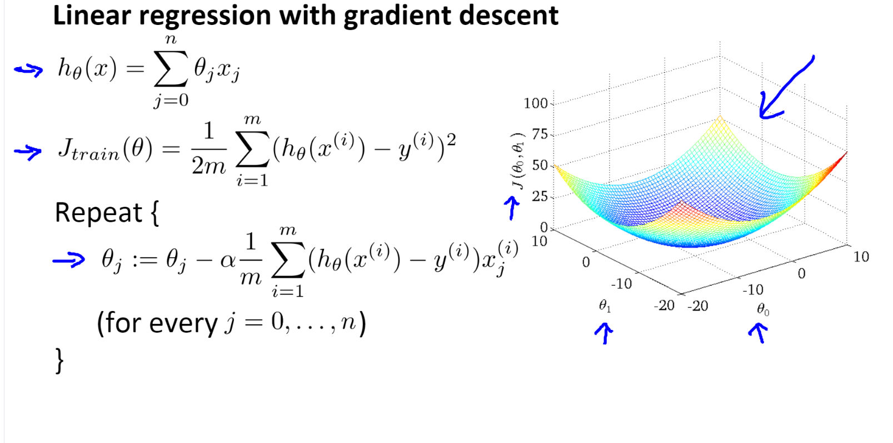
Gradient Descent Revised
Source: Andrew Ng Coursera

Slide 6
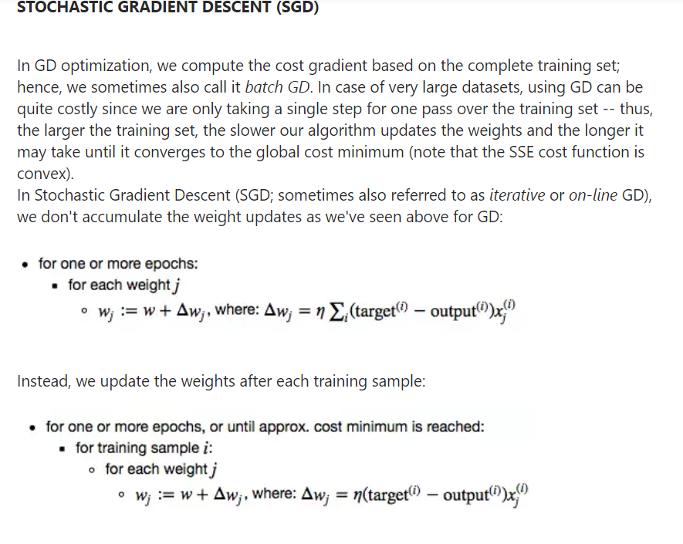
SGD

Slide 7
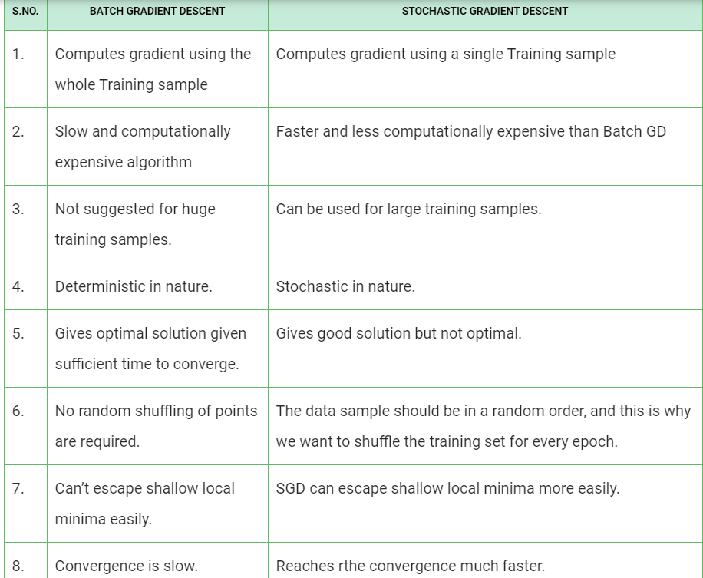

Slide 8
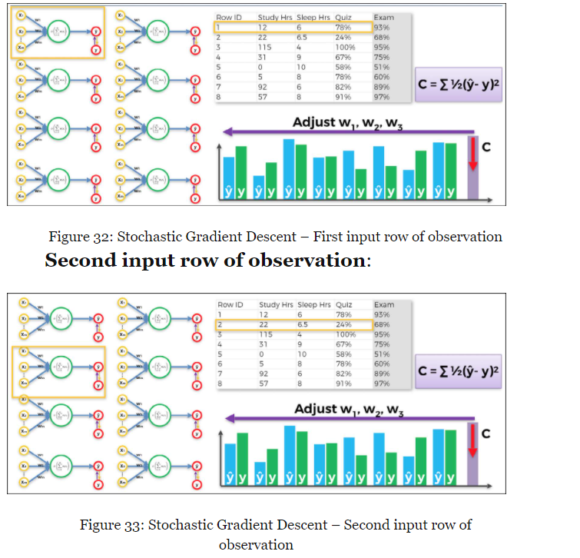
Source: Crash Course in AI Hadelin Ponteeves

Slide 9
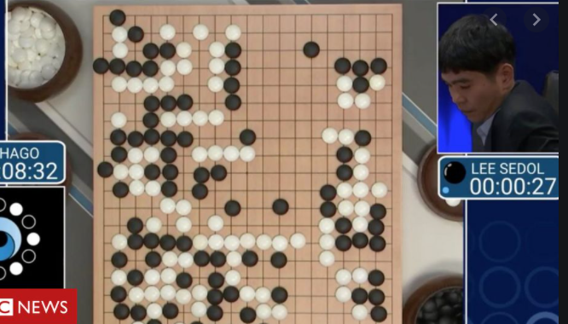
Reinforcement Learning
Reinforcement learning (RL) is an area of machine learning that focuses on how you, or how some thing, might act in an environment in order to maximize some given reward.
Reinforcement learning algorithms study the behavior of subjects in such environments and learn to optimize that behavior.
A commonly referred to domain that can illustrate the power of reinforcement learning is in game playing.

Slide 10
Markov Decision Processes source: deep lizard
In an MDP, we have a decision maker, called an agent, that interacts with the environment it's placed in.
These interactions occur sequentially over time.
At each time step, the agent will get some representation of the environment’s state.
Given this representation, the agent selects an action to take. The environment is then transitioned into a new state, and the agent is given a reward as a consequence of the previous action.
Components of an MDP:
Agent
Environment
State
Action
Reward

Slide 11
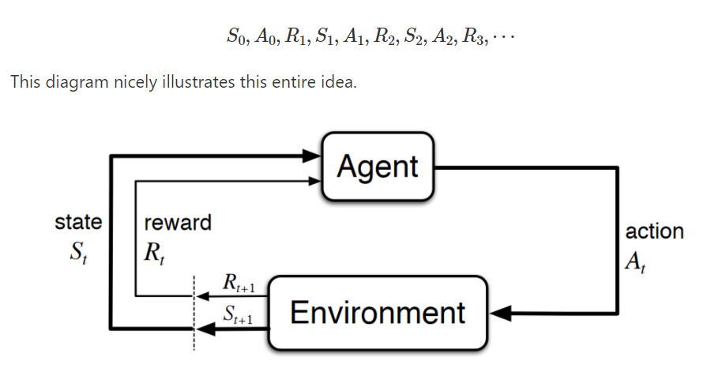
Markov Decision Processes source: deep lizard
This process of selecting an action from a given state, transitioning to a new state, and receiving a reward happens sequentially over and over again, which creates something called a trajectory that shows the sequence of states, actions, and rewards.
Throughout this process, it is the agent’s goal to maximize the total amount of rewards that it receives from taking actions in given states.
This means that the agent wants to maximize not just the immediate reward, but the cumulative rewards it receives over time.

Slide 12
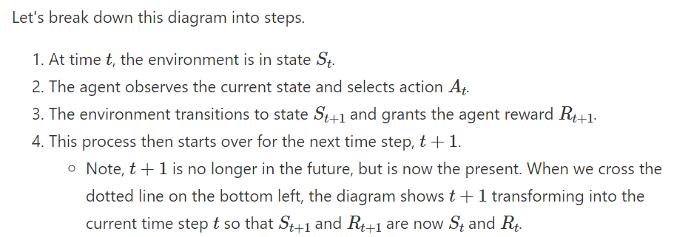
Markov Decision Processes source: deep lizard

Slide 13
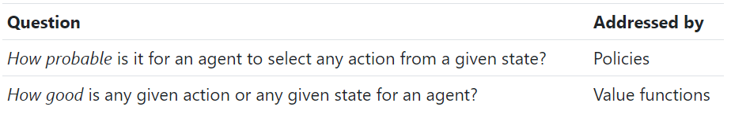
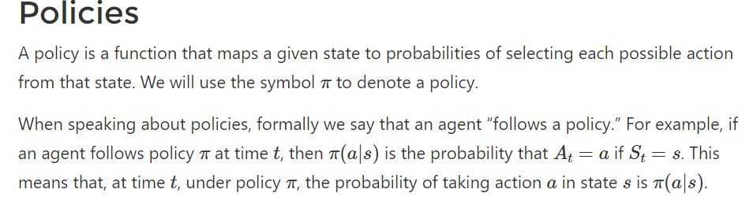
Markov Decision Processes source: deep lizard
Policies And Value Functions
For each state s E S, P or pie symbol is a probability distribution over a E A.

Slide 14
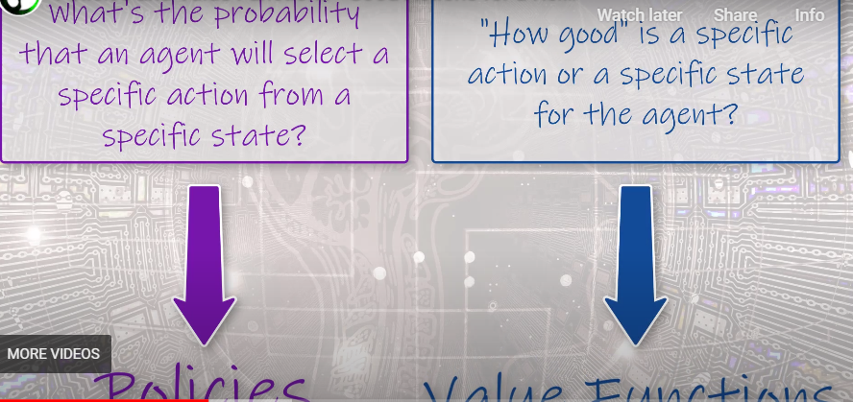
Values Functions and Policies Summary

Slide 15
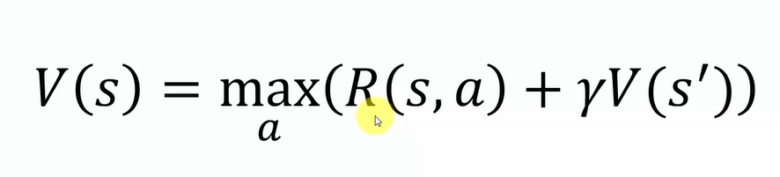
Bellman Equation
the Bellman equation decomposes the value function into two parts, the immediate reward plus the discounted future values.

Slide 16
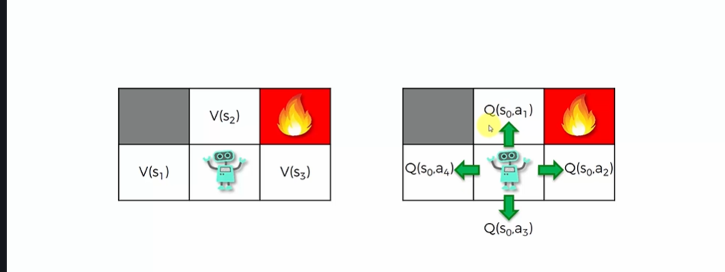
Where is Q?
V represents value of action at state
Q represents quality of action taken at state s

Slide 17
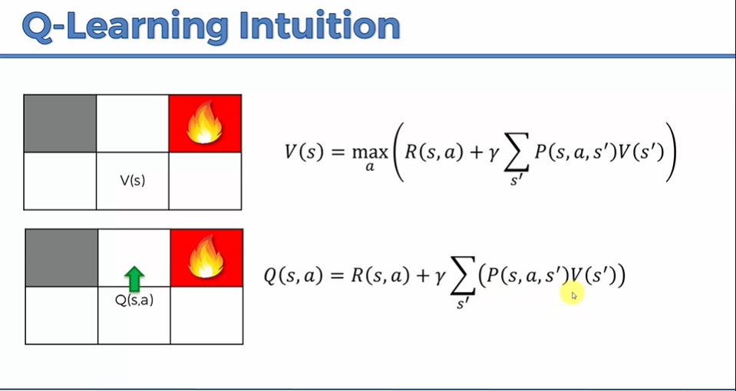
Q- Learning Formula
First Formula – calculation of V
Second Formula – calculation of Q

Slide 18
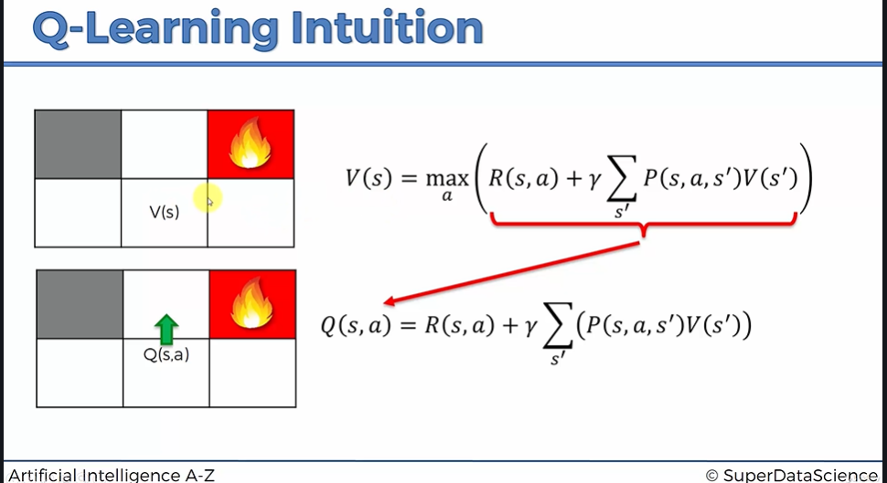
Relation between V and Q Formulas
Q is value inside brackets of the V function. V is a recursive function.
This happens as V calculates maximum of all possible actions values and each one is Q itself

Slide 19
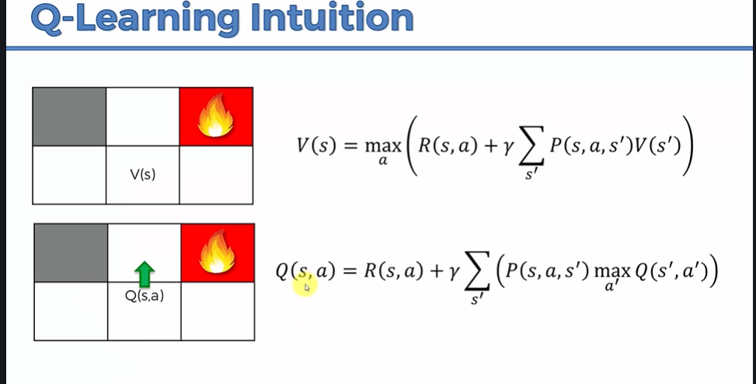
Final Q-Learning Formula
After making some mathematical formula substitutions the Q formula can be written as above.

Slide 20
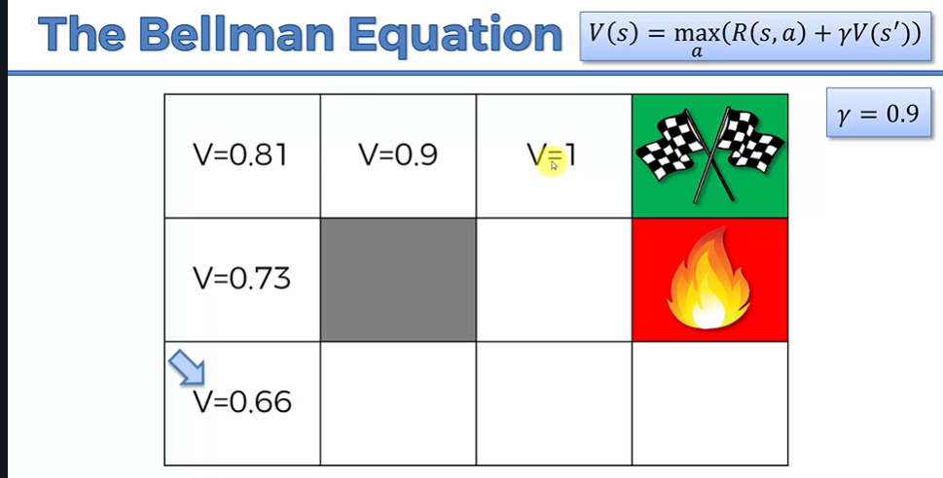
Bellman Equation Example

Slide 21
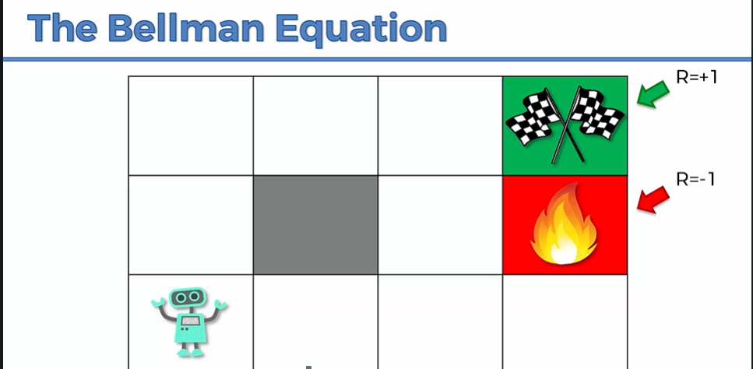
Bellman Equation Intuition

Slide 22
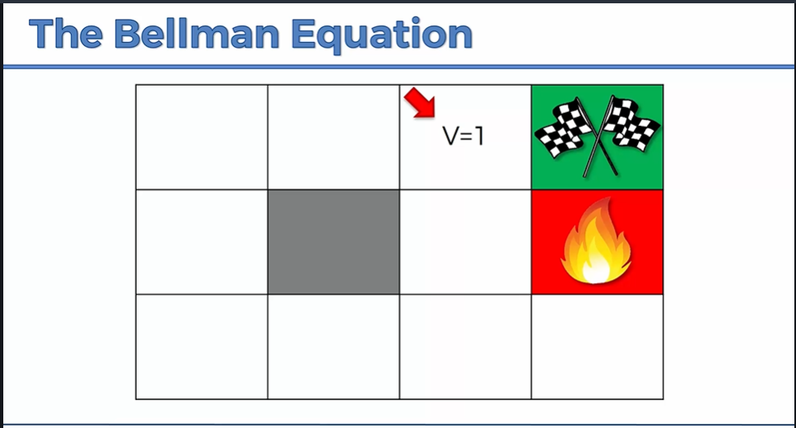
Bellman Equation Intuition

Slide 23
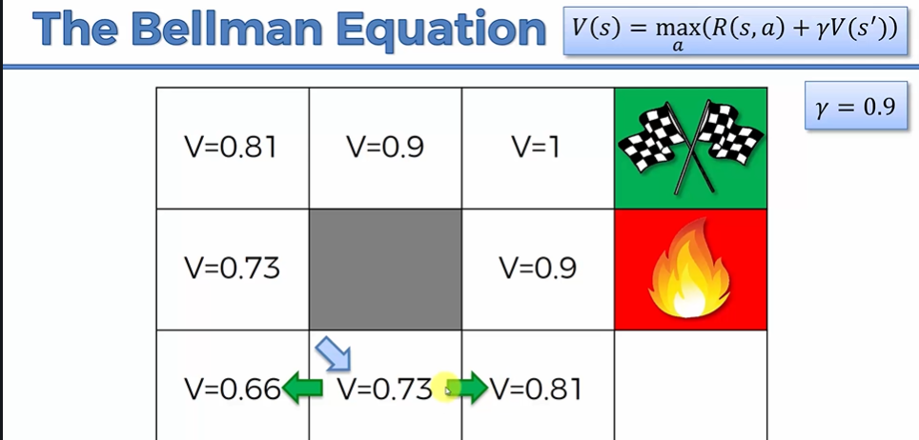
Bellman Intuition

Slide 24
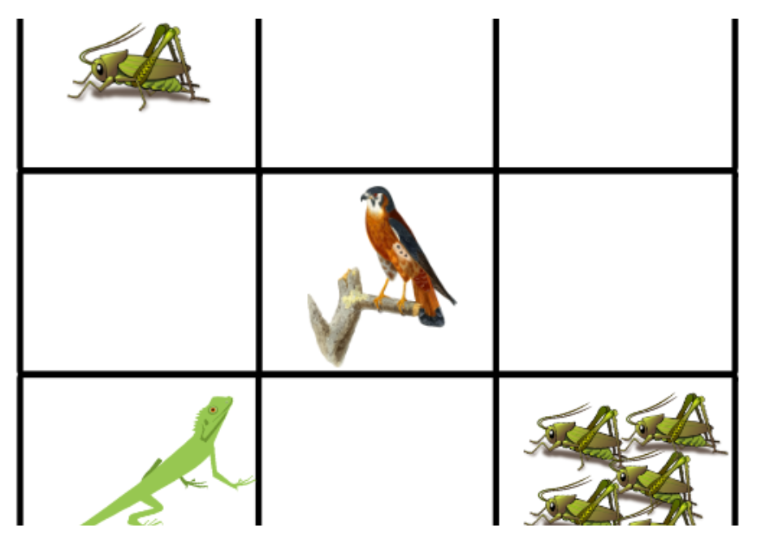
Q Learning Process
To left is the environment we are using.
Lizard is an agent
If it eats cricket it gets a reward
If it goes near the bird, it gets eaten up
Rewards are positive and negative.
Lets look at our reward table in the next slide.

Slide 25
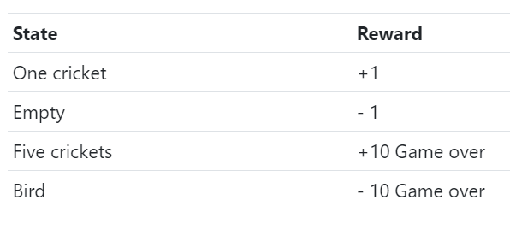
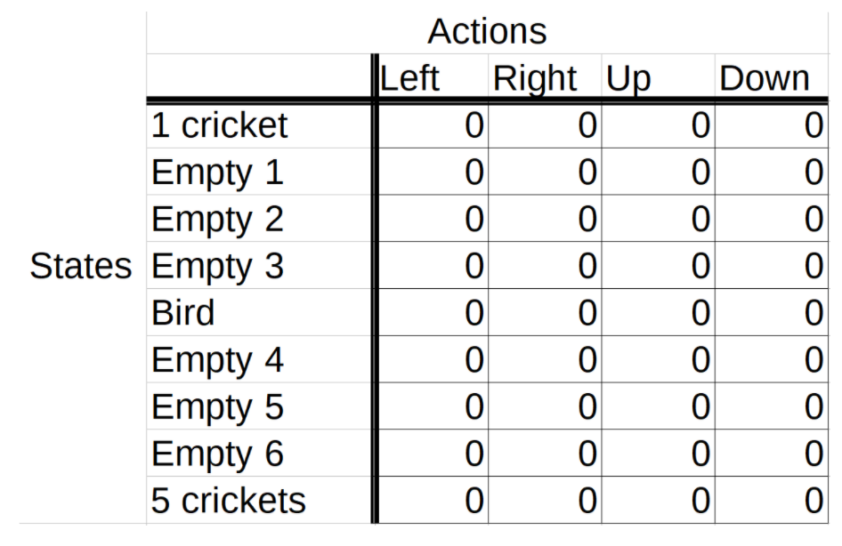
Rewards and initial Q-Table
Initial rewards are defined above.
A q table is maintained and updated as agent interacts again and again with an environment over time.
It gets updated over time.
In each episode, the lizard starts out by choosing an action from the starting state based on the current Q-values in the table.
The lizard chooses the action based on which action has the highest Q-value in the Q-table for the current state.

Slide 26
Exploration and Exploitation
The goal of an agent is to maximize the expected return, so you might think that we want our agent to use exploitation all the time and not worry about doing any exploration. This strategy, however, isn’t quite right.
Think of our game. If our lizard got to the single cricket before it got to the group of five crickets, then only making use of exploitation, going forward the lizard would just learn to exploit the information it knows about the location of the single cricket to get single incremental points infinitely. It would then also be losing single points infinitely just to back out of the tile before it can come back in to get the cricket again.

Slide 27
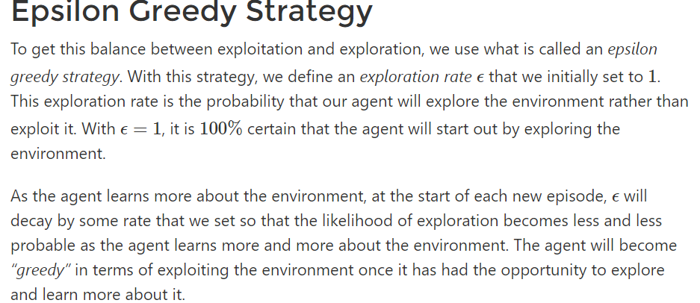
Epsilon Greedy Strategy source: deep lizard

Slide 28
Reinforcement Learning Online Demo – Eat Melon
http://projects.rajivshah.com/rldemo/

Slide 29
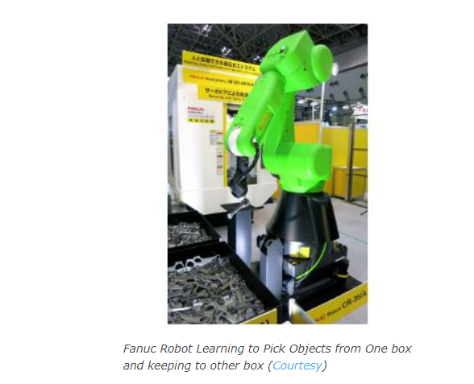
Reinforcement Learning Use Cases
Fanuc, the Japanese company, has been leading with its innovation in the field of industry-based robots.
For the past few years, Fanuc has been working actively to incorporate deep reinforcement learning in their own robots.
This Japanese Giant uses deep reinforcement learning for their robots in such a way that the robots train on their own for the most basic task of picking an object from one box and placing it into another box.
This process of training is repeated for different kinds of tasks and thus build such robots that can complete complex tasks as well.

Slide 30
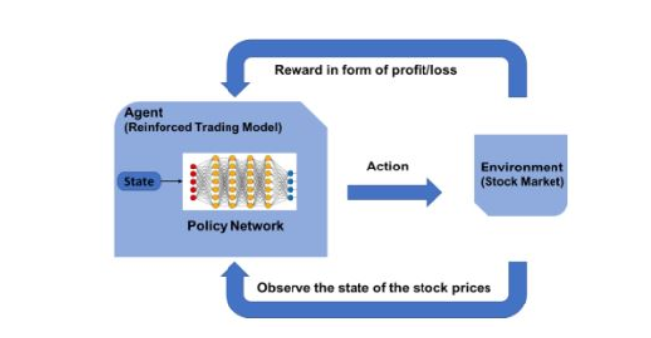
Use case 2- Trading
Pit.ai has been a pioneer in implementing stock trading through reinforcement learning.
Company’s founder Yves-Laurent Kom Samo looks to change the way reinforcement learning is used for such types of tasks, according to him.

Slide 31
Use case -3 Reduction in Energy Consumption
Tech Giant Google has leveraged reinforcement learning in the most unique way. Google has numerous data centers that can heat up extremely high. To mitigate this problem, Google uses AlphaGo built by DeepMind, for figuring out the optimal method that can help in designing the cooling infrastructure.
The aim was to reduce the energy consumed by fans and ventilation. AlphaGo is providing recommendations on how efficiently energy should be put to use in the cooling of data centers. The results were quite good as the energy requirement was reduced to 40%, thus resulting in a huge reduction in costs.

Slide 32
Topic Questions or Revisions

